Slide 1

ITE61
Operations and Post Implementation

Slide 2
Go Live Readiness
Several tasks and activities need to fall into place to Go-live, and determining the level of readiness is a challenge. If an elaborate readiness checkpoint is not in place, steps will be missed and
the Go-live will be very bumpy or, worse, have to retreat back to the old legacy system
The Go-live readiness process will clarify the progress toward completing the activities and identifying the major issues on which to focus before going live.
With the first readiness review many tasks and activities will not be completed or look close to completion. The conversion team may not have had a successful conversion, and testing will likely be problematic, especially if development is not complete.
Go-live readiness is at best tedious and time consuming. Most staff and users will be frustrated with the process during the first round of review.
Go-live readiness reviews need to be documented and communicated to the project team and the company. Readiness involves documenting the current metrics related to what remains to be completed.
The first readiness review will bring several issues to light on which to focus and, one hopes, not too many surprises. From the first to the last review, the teams will see significant project progress toward going live.

Slide 3
ERP Training
Training must be provided to everyone who will be using the system and should use real data and examples that will be performed once the system is “live”
A training program must be available with predictable results that follow the training guides and show examples.
Many organizations are using training as a validation of the users’ understanding of how to use the system. This is sometimes called a “certification” process.
With regard to operability, approximately 10–15 percent of ERP implementations have smooth introductions that deliver the anticipated benefits
ERP training can be delivered by several different methods and a variety of personnel
ERP training has become a giant business, and it is usually independent of the ERP applications themselves.

Slide 4
STABILIZATION
The stabilization process begins when the ERP system software is in production, initial training is complete, and conversion of critical data is done.
After the ERP system goes live, the organization will need to shift into a stabilization process. This process can take anywhere from 60 to 90 days, depending on the number of issues
During the stabilization period, the IT staff will be monitoring the infrastructure for response times and ensure that backups are taken appropriately for all hardware and software; hence, they are often simultaneously researching and fixing problems.
Stabilization is a demanding and frustrating period, which is characterized by long hours, many problems, and lots of anxiety.
There are strategies that the company can apply to minimize business disruptions due to stabilization problems.

Slide 5
POST PRODUCTION SUPPORT
The development of a postproduction support plan and process is as important as any set of activities outlined during the development phase.
Managing the daily system operations and ensuring that the system is doing what it needs to do is really the purpose of postproduction support. Many new processes must be understood and communicated to gain the benefits of the ERP implementation fully
Many of the risks associated with cutting over to the new ERP can be reduced by appropriate pre–Go-live and end-user training, but additional support is needed after the system is put into production.
There are numerous ways to add support to users in addition to in-person support. This includes Web-based frequently asked questions (FAQs), job aids that are printable that describe how to access and complete a function within the system, short videos on using the system, and complete training documentation that shows and describes step by step how to use the system

Slide 6
Postimplementation support
Training
Go-live support
Data validation
Data correction
Patches and fixes
New features/upgrades

Slide 7
KNOWLEDGE TRANSFER
You need to concentrate on the visible key issues in an ERP implementation, but a good project manager must work at all issues including those that are much less obvious and yet still important to the long-term ERP system success. This is exactly the case with knowledge transfer
The ERP implementation process can be divided into major phases: Requirements Gathering and Definition, Build, Go-Live, Stabilization, and Ongoing Support. Knowledge is gained and lost during any of these phases, and the most problematic time frames are moving from one phase to another.
Multiple aspects of the implementation process must be documented during the Definition and Build phases.
The team composition is likely to change in the Go-Live and Stabilization phases: Internal and external resources used in the Define and Build phases leave, especially third-party consultants, whereas new internal staff takes their place.
There are knowledge management systems that can help streamline the process of knowledge and skill transfer. With such a system in place, one centralized data repository can then be used by the implementation team to store the documents

Slide 8
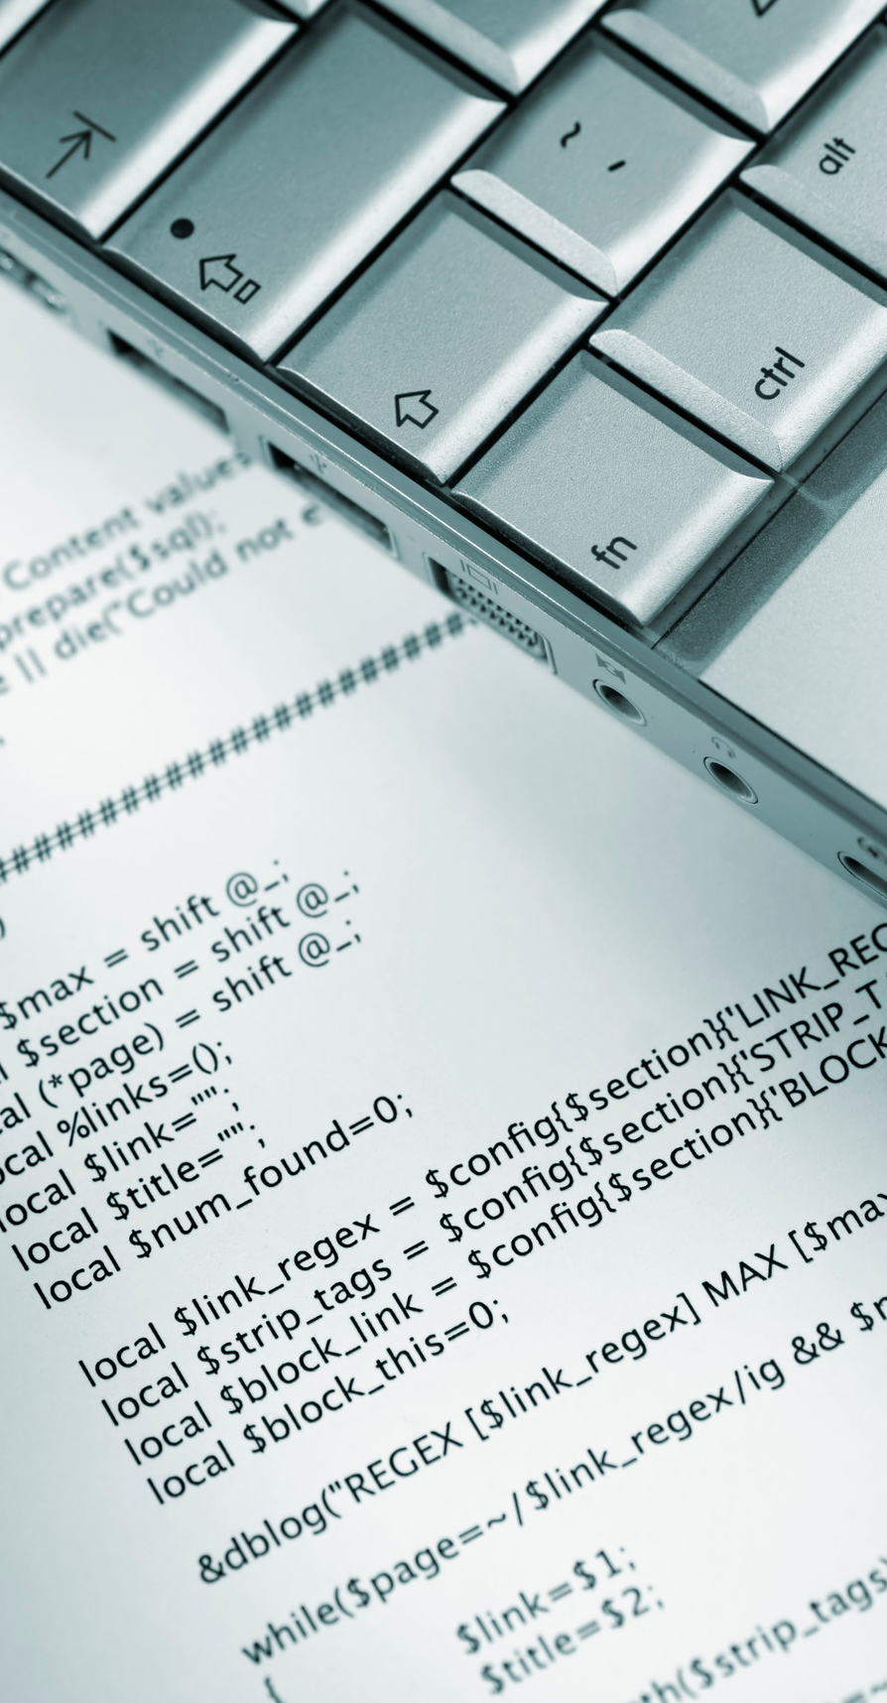
Pitch Deck
Thank You For Your Attention!

